Slide 1






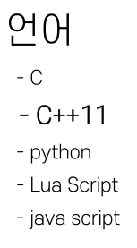
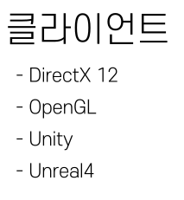



Slide 2




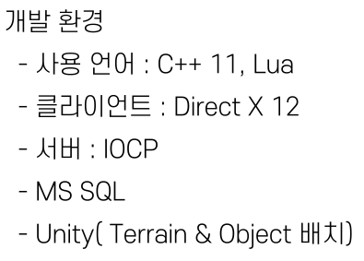
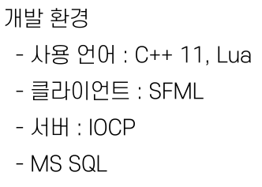


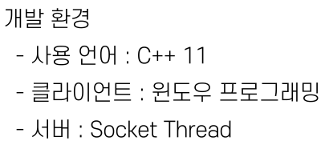
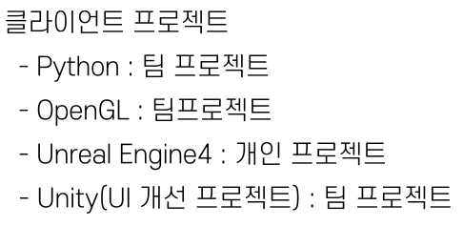

Slide 3
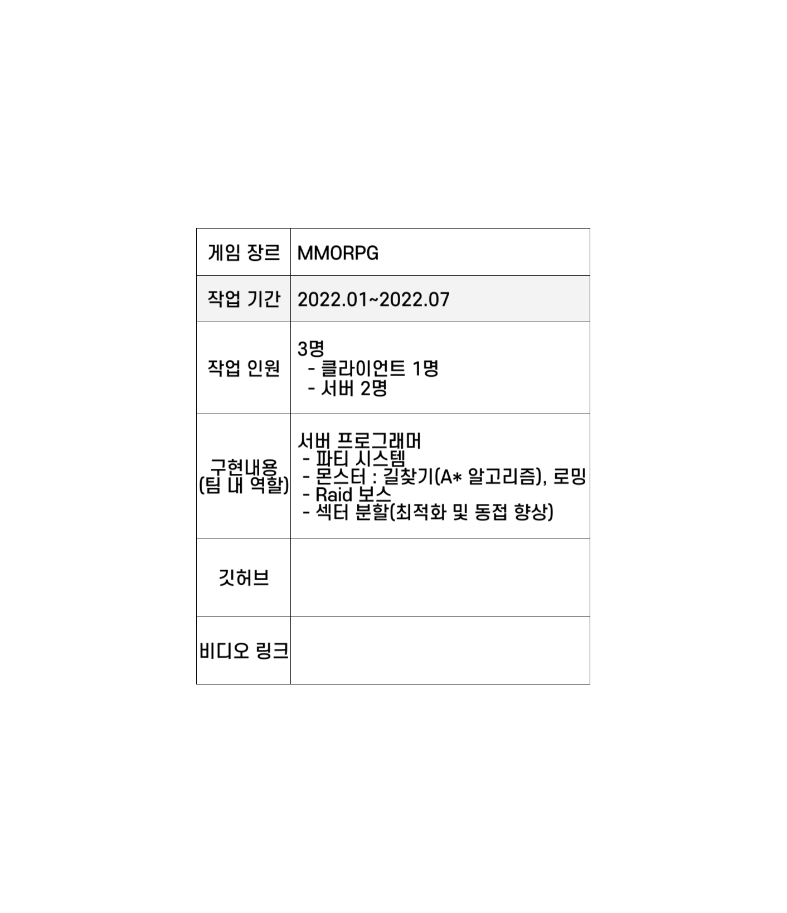


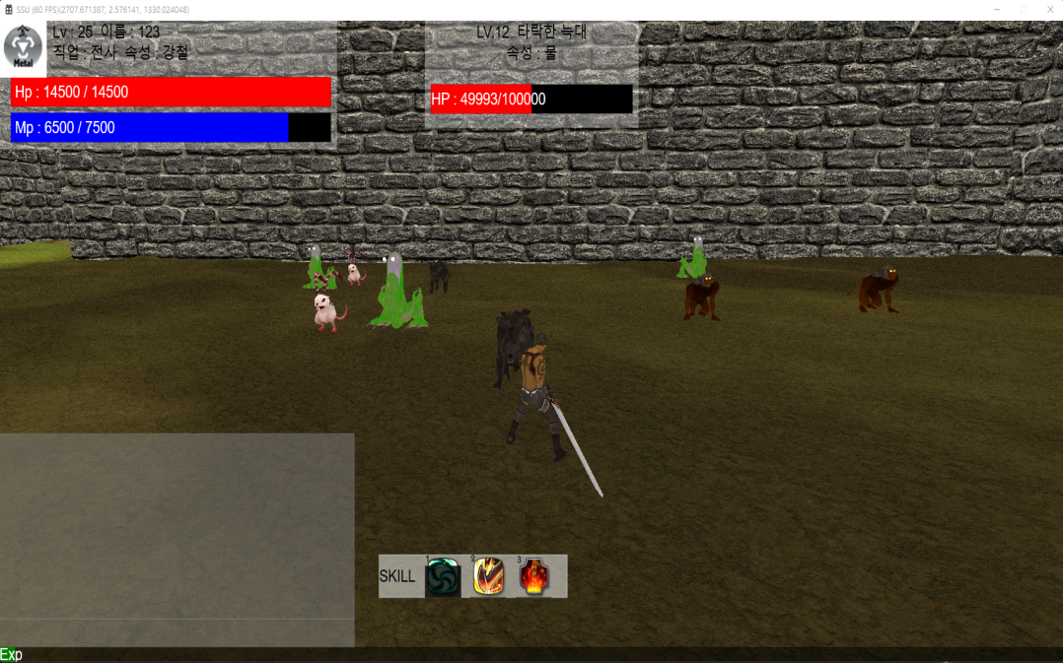
https://github.com/hjs0913/SSU
https://www.youtube.com/watch?v=QtUVavobUL8

Slide 4



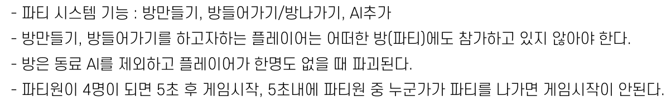
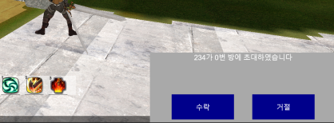

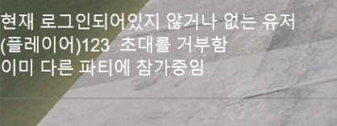

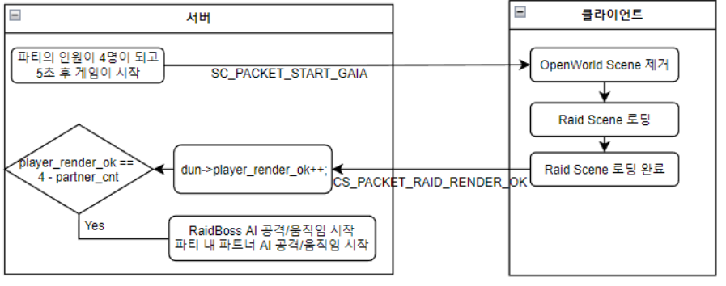

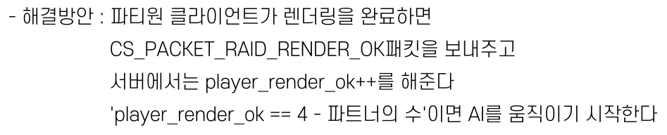

Slide 5








my_id = 99999; my_element = 6; my_lv = 19; my_name = "타락한 개구리"; my_hp = 120000;
my_physical_attack = 180; my_magical_attck = 0; my_physical_defence = 300;
my_magical_defence = 130; my_basic_attack_factor = 10; my_defence_factor = 0.0002; my_x = 0; my_y = 0; my_z = 0;
min_x = 1900; max_x = 2200; min_z = 3080; max_z = 3380;
function set_uid(id, x, y, z)
my_id = id; my_x = x; my_y = y; my_z = z;
return my_element,my_lv, my_name, my_hp, my_physical_attack, my_magical_attck,
my_physical_defence, my_magical_defence, my_basic_attack_factor, my_defence_factor;
End
function event_npc_move(player)
player_x = API_get_x(player); player_z = API_get_z(player);
x = API_get_x(my_id); z = API_get_z(my_id);
if (math.abs(my_x - x) > 120) or (math.abs(my_z - z) > 120) then
return false;
else
-- 쫒아가는 것은 C로 짠다
return true;
end
end
my_id = 99999; my_element = 0; my_lv = 100; my_name = "가이아"; my_hp = 1000000; my_physical_attack = 350;
my_magical_attck = 400; my_physical_defence = 500; my_magical_defence = 350; my_basic_attack_factor = 50;
my_defence_factor = 0.0018; my_x = 300; my_y = 0; my_z = 300;
p1_first_position_x = 0; p1_first_position_z = 0; p1_second_position_x = 0; p1_second_position_z = 0;
p1_third_position_x = 0; p1_third_position_z = 0; p1_fourth_position_x = 0; p1_fourth_position_z = 0;
function set_uid(id)
my_id = id;
return my_element, my_lv, my_name, my_hp, my_physical_attack, my_magical_attck,
my_physical_defence, my_magical_defence, my_basic_attack_factor, my_defence_factor;
End
function pattern_one_set_position(x, z, look_x, look_z, right_x, right_z)
p1_first_position_x = x + look_x*50; p1_first_position_z = z + look_z*50;
p1_second_position_x = x - look_x*50; p1_second_position_z = z - look_z*50;
p1_third_position_x = x + right_x*50; p1_third_position_z = z + right_z*50;
p1_fourth_position_x = x - right_x*50; p1_fourth_position_z = z - right_z*50;
return p1_first_position_x, p1_first_position_z, p1_second_position_x, p1_second_position_z,
p1_third_position_x, p1_third_position_z, p1_fourth_position_x, p1_fourth_position_z;
end
function pattern_one_set_damage(player)
player_x = API_get_x(player); player_z = API_get_z(player);
dis1=math.sqrt(math.pow((player_x - p1_first_position_x),2) + math.pow((player_z - p1_first_position_z),2));
dis2=math.sqrt(math.pow((player_x - p1_second_position_x),2)+math.pow((player_z - p1_second_position_z),2));
dis3=math.sqrt(math.pow((player_x - p1_third_position_x),2)+math.pow((player_z - p1_third_position_z), 2));
dis4=math.sqrt(math.pow((player_x - p1_fourth_position_x),2)+math.pow((player_z - p1_fourth_position_z), 2));
p_hp = API_get_hp(player);
if((dis1 < 20) or (dis2 < 20) or (dis3 < 20) or (dis4 < 20)) then
return p_hp - 2000;
else
return p_hp;
end
end

Slide 6

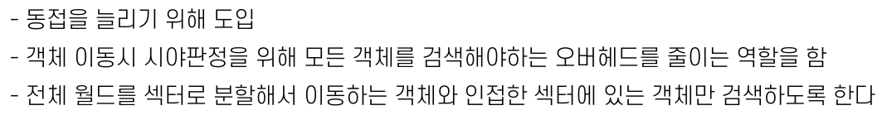



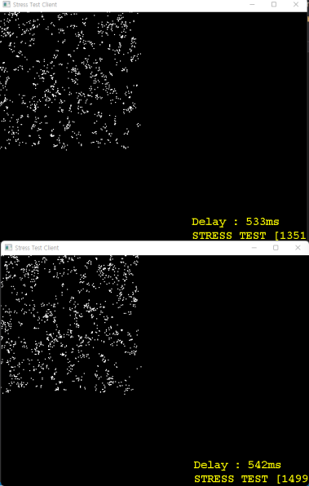
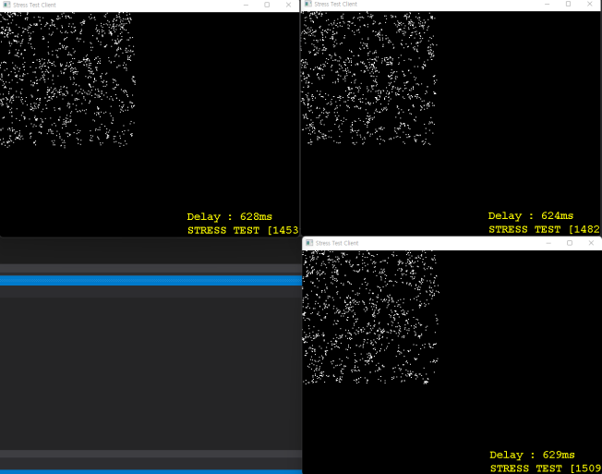
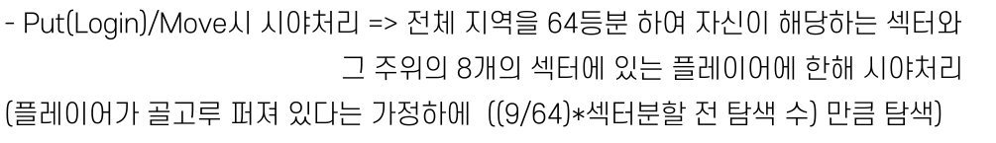
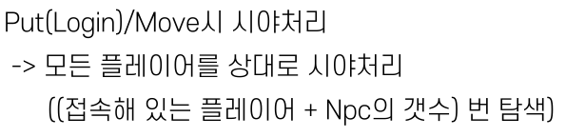
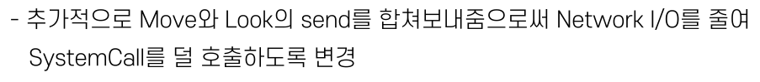

Slide 7
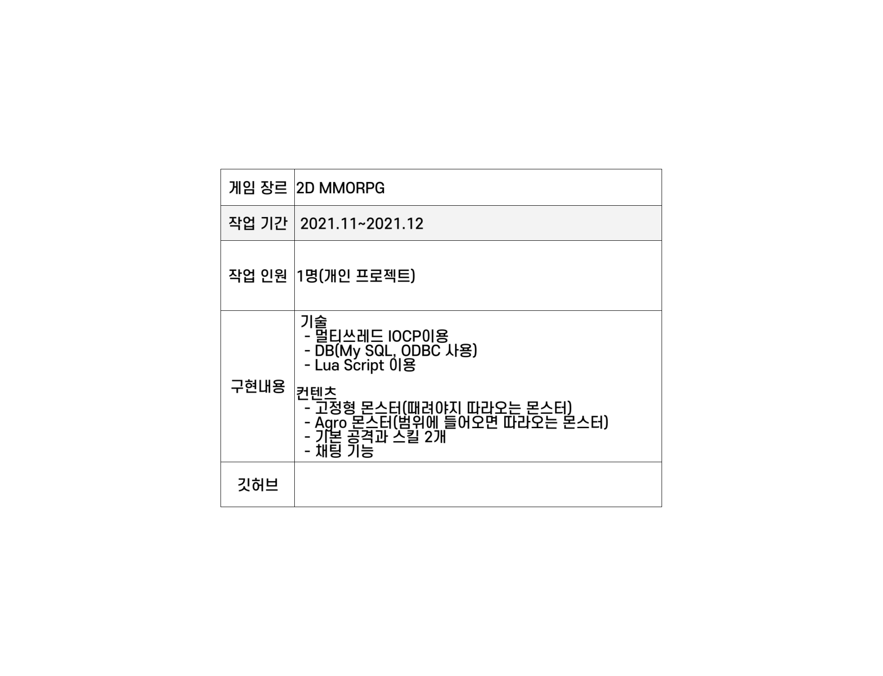


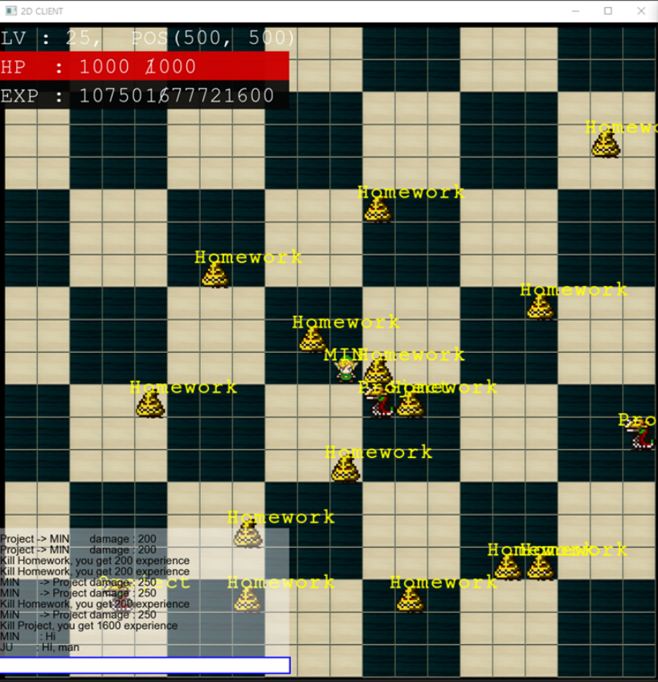
https://github.com/Asias-ara/2021-2GameServer-TermProject

Slide 8



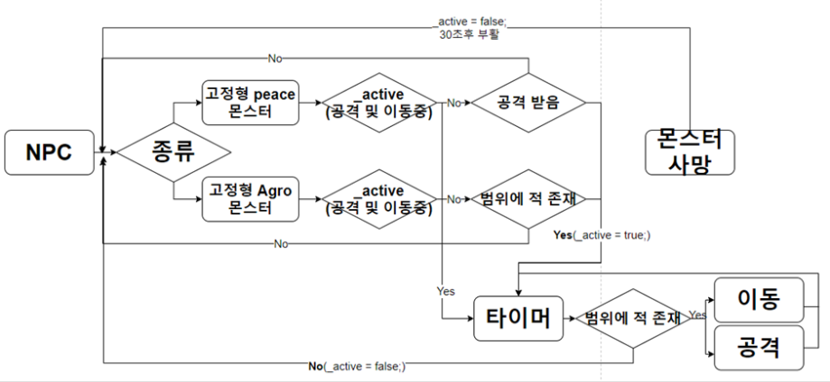

class Npc
{
protected:
char_name[MAX_NAME_SIZE];
int_id;
int_hp;
int_maxhp;
short_lv;
int_exp;
short_x, _y;
TRIBE_tribe;
STATE_state;
atomic_bool_active;// NPC가 가만히 안있고 움직일때
public:
mutexstate_lock;
mutexlua_lock;
lua_State* L;

Slide 9




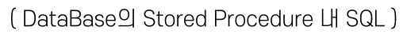
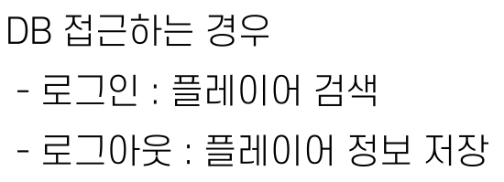
ALTER PROCEDURE [dbo].[search_player]
@param int
AS
BEGIN
SET NOCOUNT ON;
SELECT p_id, p_name, p_x, p_y, p_hp, p_lv, p_exp, p_maxhp FROM player_data WHERE p_id = @param
END
ALTER PROCEDURE [dbo].[save_player_info]
@id_param int,
@x_param int,
@y_param int,
@hp_param int,
@lv_param int,
@exp_param int,
@maxhp_param int
AS
BEGIN
SET NOCOUNT ON;
UPDATE player_data SET p_x = @x_param, p_y = @y_param, p_hp = @hp_param, p_lv = @lv_param, p_exp = @exp_param, p_maxhp = @maxhp_param WHERE p_id = @id_param
END

Slide 10



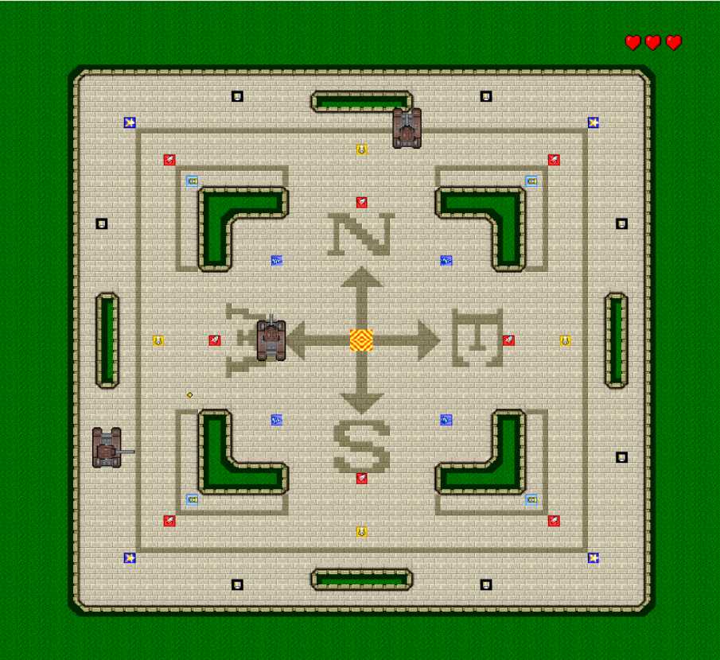
https://github.com/Asias-ara/NGP_TermProject

Slide 11



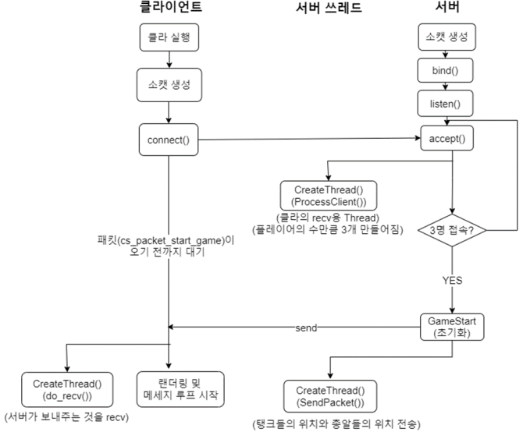
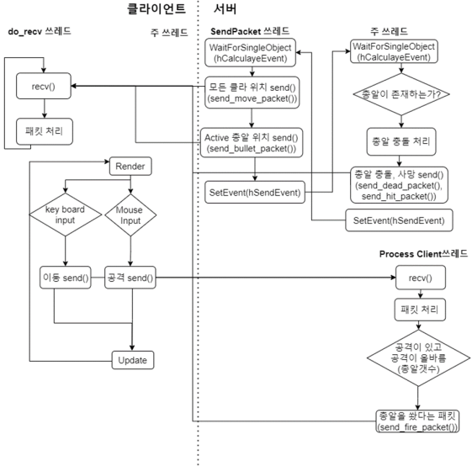
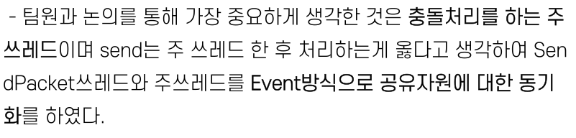
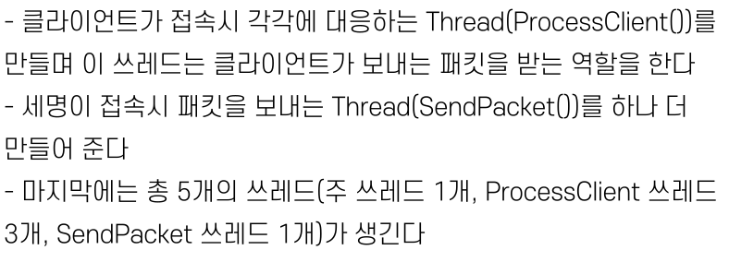


Slide 12
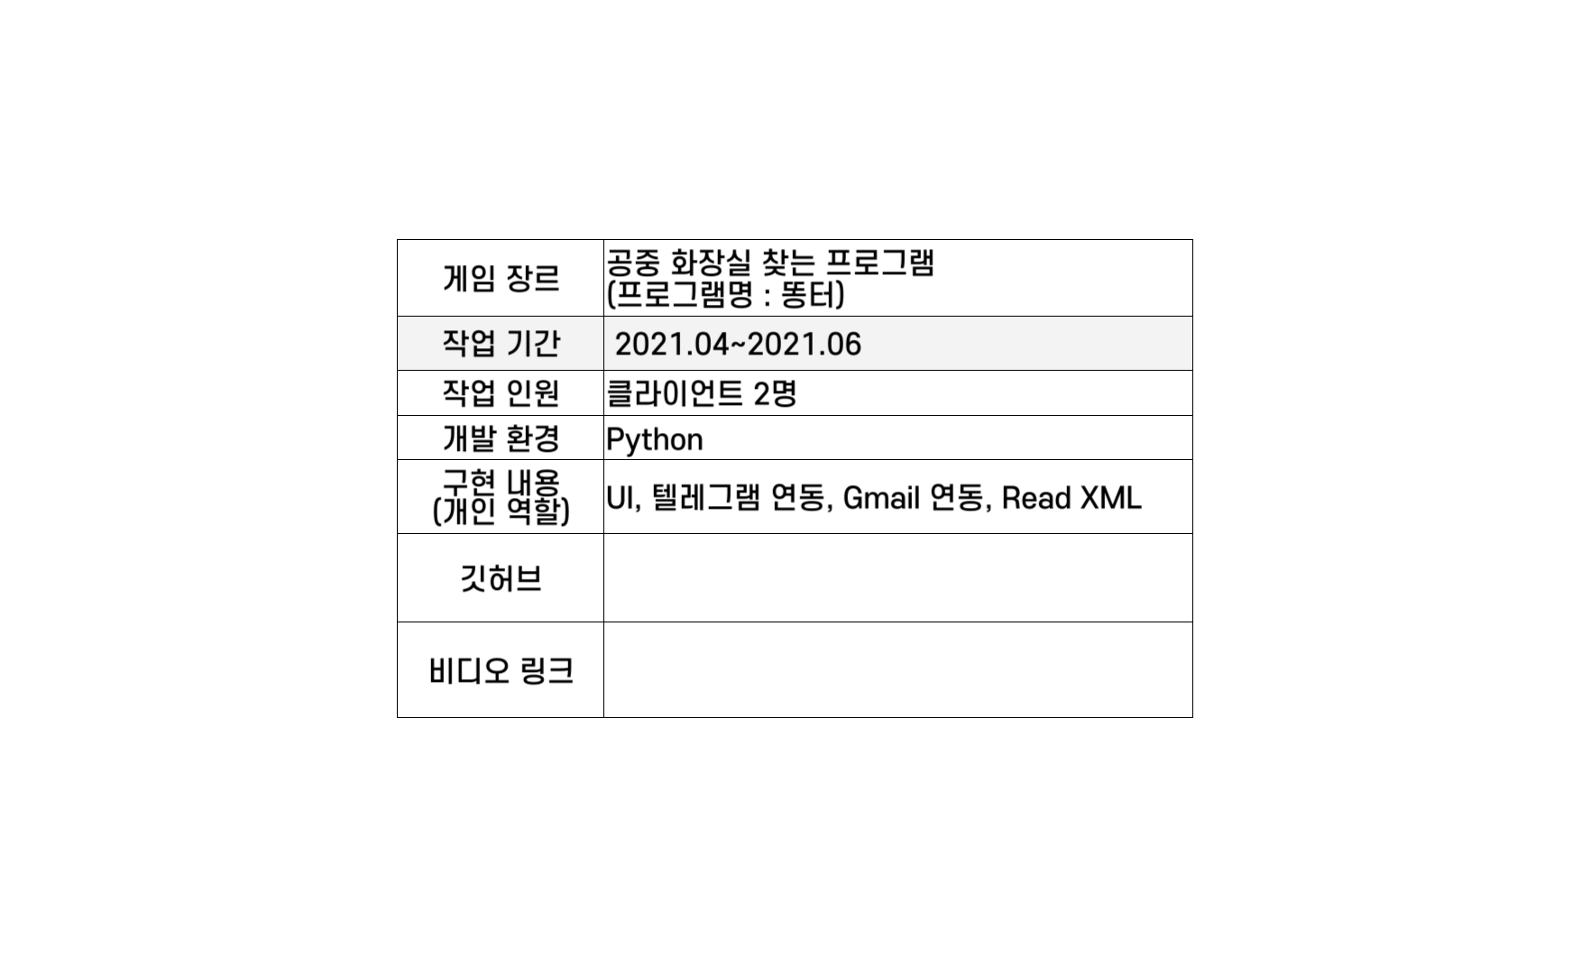


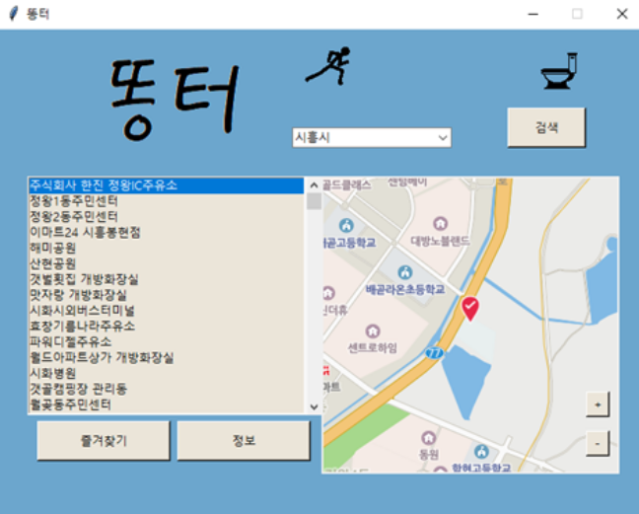
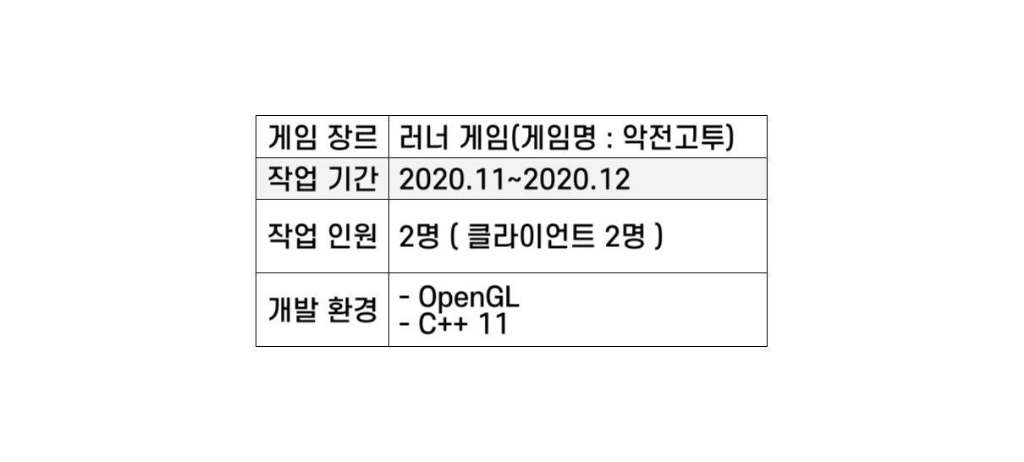
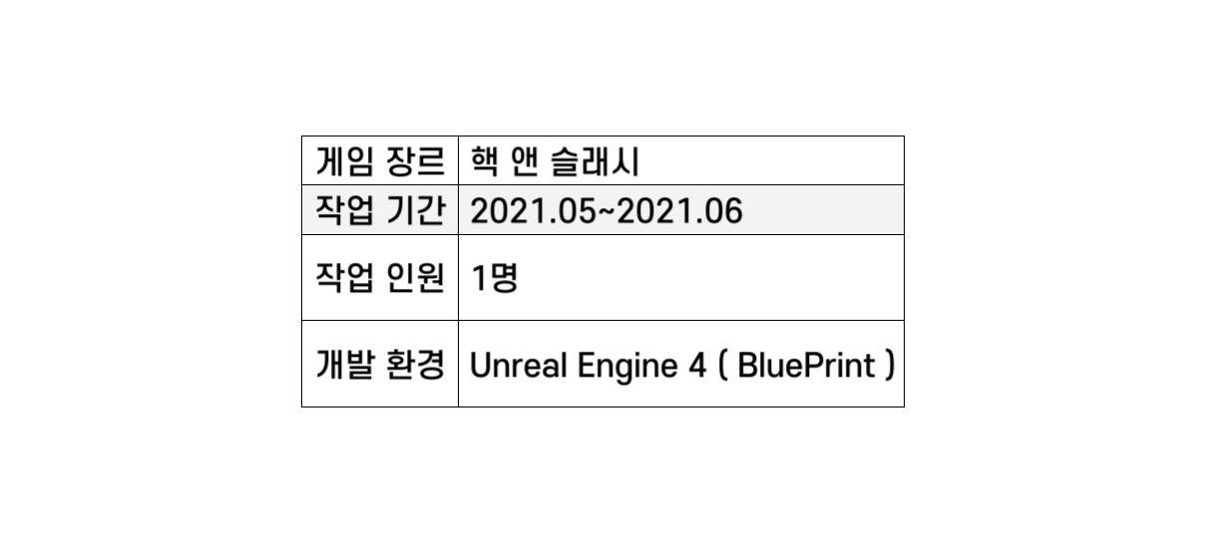
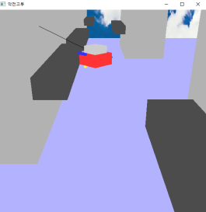
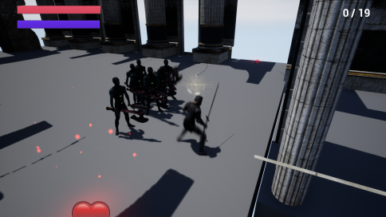
https://github.com/boy0501/ScriptLanguage
https://www.youtube.com/watch?v=9xJmV3VbE9A

Slide 13
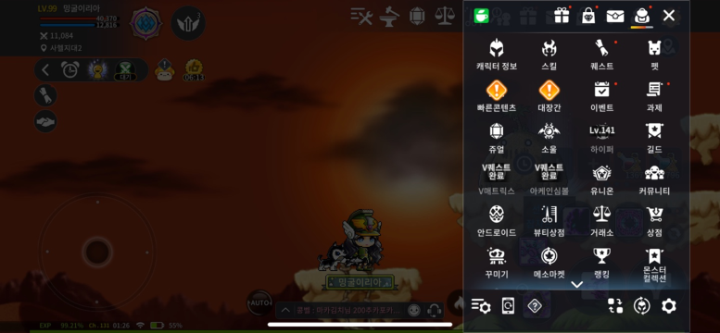
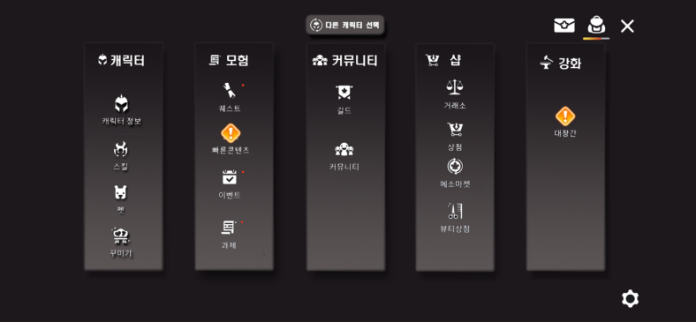
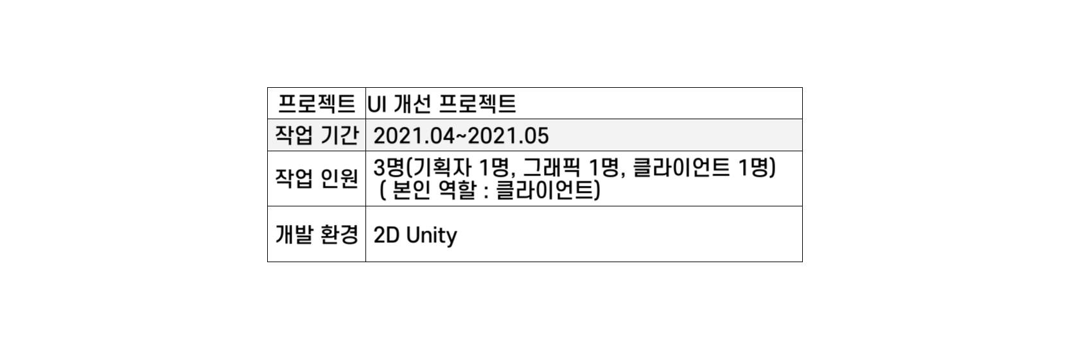
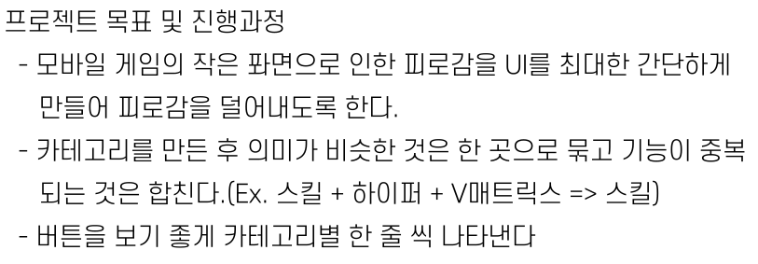


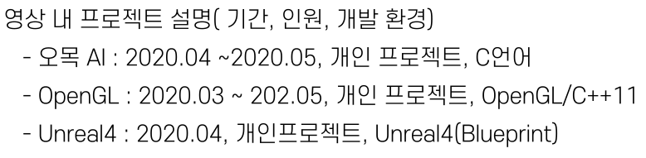
전체적으로 보기가 어지러움
https://www.youtube.com/watch?v=fxH1n6ZDOX8

